Slide 1
Secure data hiding in image using steganography
Presented By:
Student Name : R SAI LASYA AMRUTHA
College Name & Department : SRI INDU COLLEGE OF ENGINEERING AND TECHNOLOGY & CYBER SECURITY

Slide 2
OUTLINE
Problem Statement
Technology used
Wow factor
End users
Result
Conclusion
Git-hub Link
Future scope

Slide 3
Problem Statement
Steganography is the practice of hiding information within digital media to ensure secure communication. In this project, we focus on embedding a secret message into an image without altering its visual appearance, ensuring data confidentiality and security.

Slide 4
Technology used
Programming Language: Python
Libraries: OpenCV,OS,STRING
Image Processing: Least Significant Bit (LSB) Method
Security Mechanism: Passcode-Based Decryption

Slide 5
Wow factors
Uses LSB technique for efficient and secure data hiding.
Supports passcode-based decryption, ensuring confidentiality.
Minimal alteration to the original image, making detection difficult.
Lightweight and easy to implement.

Slide 6
End users
Cybersecurity professionals
Law enforcement agencies
Journalists & whistleblowers
Secure data transfer applications

Slide 7
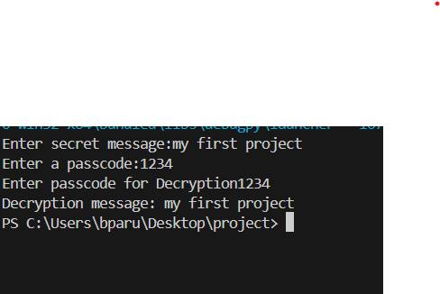


Results
Original image: Encrypted Image:
Secret message and passcode

Slide 8
Conclusion
This project successfully demonstrates a method to securely hide and retrieve sensitive data within an image. By using steganography, we ensure that the information remains hidden from unauthorized users while maintaining the visual integrity of the image. This technique has vast applications in secure communications and data privacy.

Slide 9
GitHub Link
lasya-meghu/stegnography: as a part of my project

Slide 10
Future scope
Enhancing Security: Implementing additional encryption layers before embedding data.
Increasing Capacity: Exploring more efficient encoding techniques.
Steganalysis Resistance: Developing mechanisms to evade detection algorithms.
Cross-Media Applications: Extending the technique to video and audio files.

Slide 11
THANK YOU

